Slide 1
OPER 618 Lesson 07 Extensive Form Games with Perfect Information
Dr. Brian J. Lunday
Office: Rm 201E, Bldg 641

Slide 2
On Extensive Form Games
What is an extensive form game?
An interaction between 2 or more players in which decisions are made sequentially, and their collective decisions affect their outcomes.
What extensive form games do we encounter in daily life, as a person?
What extensive form games do we encounter, as an organization?
What extensive form games do we encounter, as a nation?

Slide 3












Halloween Costume Selection Tree Representation
Player 1 picks first, and we can’t have two Batmans or two Robins.
$$u_{1}\left(Bat,Rob\right)>u_{1} \left(Rob,Bat\right) >u_{1}\left(Bat,Aqmn\right)>u_{1}\left(Rob,Aqmn\right)$$
$$u_{2} \left(Rob,Bat\right)>u_{2}\left(Bat,Rob\right)>u_{2}(Bat,Aqmn)>u_{2}\left(Rob,Aqmn\right)$$
This game tree illustrates
Two players: $N=\left\{1,2\right\}$
Four terminal histories. (I.e., the sequence of decisions resulting in the outcome.)
At each stage in a terminal history, who is making a decision
Player preferences among the outcomes.
1
$$Batman$$
$$Robin$$
2
2
$$Aquaman$$
$$Robin$$
$$Batman$$
$$Aquaman$$
$$\left(u_{1},u_{2}\right)=$$
$$(2,2)$$
$$(4,3)$$
$$(3,4)$$
$$(1,1)$$

Slide 4

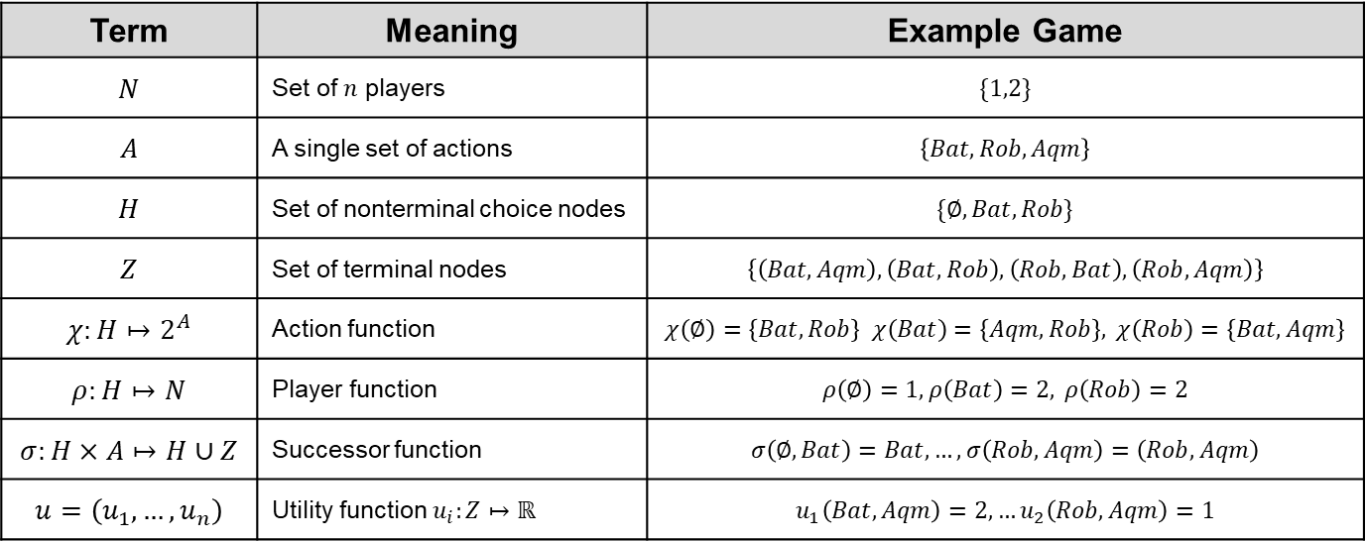



Defining the Game $$G=(N,A,H,Z,χ,ρ,σ, u)$$
1
$$Batman$$
$$Robin$$
2
2
$$Aquaman$$
$$Robin$$
$$Batman$$
$$Aquaman$$
$$(2,2)$$
$$(4,3)$$
$$(3,4)$$
$$(1,1)$$
Term | Meaning | Example Game
$$N$$ | Set of $n$ players | $$\{1,2\}$$
$$A$$ | A single set of actions | $$\left\{Bat,Rob,Aqm\right\}$$
$$H$$ | Set of nonterminal choice nodes | $$\{∅,Bat, Rob\}$$
$$Z$$ | Set of terminal nodes | $$\left\{\left(Bat,Aqm\right), \left(Bat,Rob\right), \left(Rob, Bat\right), \left(Rob,Aqm\right)\right\}$$
$$χ:H↦2^{A}$$ | Action function | $$χ\left(∅\right)=\left\{Bat,Rob\right\} χ\left(Bat\right)=\left\{Aqm,Rob\right\}, χ\left(Rob\right)=\left\{Bat,Aqm\right\}$$
$$ρ:H↦N$$ | Player function | $$ρ\left(∅\right)=1, ρ\left(Bat\right)=2, ρ\left(Rob\right)=2$$
$$σ:H×A↦H∪Z$$ | Successor function | $$σ\left(∅,Bat\right)=Bat, …,σ\left(Rob,Aqm\right)=\left(Rob,Aqm\right)$$
$$u=\left(u_{1},…,u_{n}\right)$$ | Utility function $u_{i}:Z↦ℝ$ | $$u_{1}\left(Bat,Aqm\right)=2,…u_{2}\left(Rob,Aqm\right)=1$$

Slide 5


Halloween Costume Selection (Classifying the Game)
This is a finite two-player, extensive form, game with complete information and perfect information.
What’s a perfect information game?
At any stage, you know all of the decisions that already happened.
What types of sequential decisions by multiple players have perfect information?
What types don’t, and how might you classify that information?
Completely unknown
Unknown but with some relatively likelihoods (probabilities).
1
$$Batman$$
$$Robin$$
2
2
$$Aquaman$$
$$Robin$$
$$Batman$$
$$Aquaman$$
$$\left(u_{1},u_{2}\right)=$$
$$(2,2)$$
$$(4,3)$$
$$(3,4)$$
$$(1,1)$$

Slide 6

Halloween Costume Selection (Solving the Game)
Given the game tree representation
What will you pick if your friend has picked Batman? Why?
What will you pick if your friend has picked Robin? Why?
Given utility-maximizing logic, what will your friend pick?
This technique is known as backward induction.
It can solve all finite, perfect & complete information extensive form games.
The solution is known as the subperfect equilibrium (SPE)
A subperfect equilibrium (SPE) is a set of strategies that are optimal for any subgame of the tree.
1
$$Batman$$
$$Robin$$
2
2
$$Aquaman$$
$$Robin$$
$$Batman$$
$$Aquaman$$
$$\left(u_{1},u_{2}\right)=$$
$$(2,2)$$
$$(4,3)$$
$$(3,4)$$
$$(1,1)$$

Slide 7









Classic Extensive-Form Game Market Entry
A finite, two-player, extensive form, game with complete & perfect information.
Firm 2 is already active in a niche market.
$N=\{1,2\}$, with terminal histories $z_{1}=(don^{′}t enter market)$, $z_{2}=(enter market, fight)$ and $z_{3}=(enter market, acquiesce)$ and utilities as shown on the game tree below
What can you make of this game?
1
$$don^{′}t enter market$$
$$enter market$$
2
2
$$\left(u_{1},u_{2}\right)=$$
$$(0,2)$$
$$fight$$
$$acquiesce$$
$$(−0.5,1.5)$$
$$(1,1)$$

Slide 8










Classic Extensive-Form Game Market Entry: Discussion
Given the original game.
If you’re Player #1 and could change one part of this game, what would you change?
1
$$don^{′}t enter market$$
$$enter market$$
2
2
$$\left(u_{1},u_{2}\right)=$$
$$(0,2)$$
$$fight$$
$$acquiesce$$
$$(−0.5,1.5)$$
$$(1,1)$$
1
$$don^{′}t enter market$$
$$enter market$$
2
2
$$\left(u_{1},u_{2}\right)=$$
$$(0,2)$$
$$fight$$
$$acquiesce$$
$$(−1.1,0.9)$$
$$(1,1)$$
Make it a brutal fight!

Slide 9
Classic Extensive-Form Game Market Entry: Normal Form Representation
Given the original game.
You can represent it as a normal form game.
What insights can you garner from this representation?
What information does it lack?
1
$$don^{′}t enter market$$
$$enter market$$
2
2
$$\left(u_{1},u_{2}\right)=$$
$$(0,2)$$
$$fight$$
$$acquiesce$$
$$(−0.5,1.5)$$
$$(1,1)$$
Player 1 |  | Player 2
 |  | $$fight$$ | $$acquiesce$$
 | $$enter$$ | $$(−0.5,1.5)$$ | $$(1,1)$$
 | $$don^{′}t enter$$ | $$(0,2)$$ | $$(0,2)$$

Slide 10

Market Entry Game Adaptation Sexual Assault Reporting
$N=\left\{1,2\right\}$
Player #1 is the victim of an unwanted sexual contact.
Player #2 is the referring authority (for UCMJ) in the chain of command.
Of note, 59% of situations involving unwanted sexual contact involved alcohol use by the alleged offender and/or victim.*
The terminal histories are as shown with a possible set of payoffs.
Is this game tree and resulting SPE realistic? Under what circumstances?
What can be done about changing the SPE?
1
$$report$$
$$don^{′}t report$$
2
2
$$(1,0)$$
$$investigate \& punish both offenses$$
$$investigate assault;ignore alcohol offenses$$
$$\left(u_{1},u_{2}\right)=$$
$$(0,2)$$
$$(2,1)$$
* 2012 survey of cadets and midshipmen at the military service academies.

Slide 11


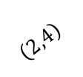




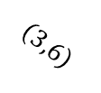




An Extensive Form Network-based Application
Consider a road network depicting paths from City 1 to City 7, with the time of travel indicated on each arc.
Your enemy (Player #2) will chose a path that has the shortest travel time.
You (Player #1) can monitor one arc with a UAV to deter the enemy from using that arc, lest he be targeted and destroyed.
Due to operational restrictions, you can only target arcs in the shaded region.
Which arc should you target?
Questions
What happens if you have more UAVs? What if he has more routes?
How can you change the game, as the interdictor?
Change the utilities. How might this be done?
Make your actions covert (i.e., interdiction instead of deterrence).
Deter with an unarmed assets, target with an armed asset.
1
5
$$\left(2,4\right)$$
$$\left(3,6\right)$$
2
4
$$\left(2,5\right)$$
3
6
6
1
5
4
7
2
2
2
3
5
3
7
2
$$\left(2,4\right)$$
$$\left(3,6\right)$$
$$\left(2,4\right)$$
$$\left(3,6\right)$$
$$\left(2,4\right)$$
$$\left(3,6\right)$$
6
$$\left(2,5\right)$$
$$\left(2,5\right)$$
$$\left(2,5\right)$$
UAV Base
$$(5,0)$$
$$(0,3)$$
$$(2,1)$$
$$(1,2)$$
$$(5,0)$$
$$(2,1)$$
$$(1,2)$$
$$(0,3)$$
$$(5,0)$$

Slide 12
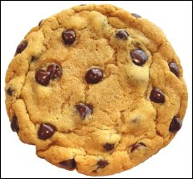
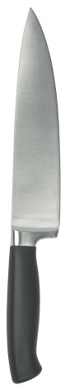
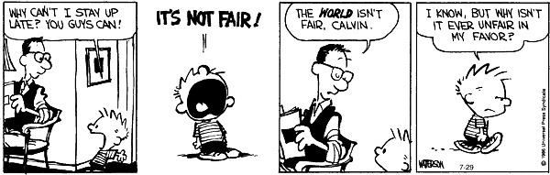

EF Game w/Infinite Action Space 2-Player Resource Sharing
There are two players, $N=\left\{1,2\right\}$.
Player $1$ makes one cut in the cookie.
Player $2$ chooses between the resulting two pieces.
Player $1$ receives the leftover piece.

Slide 13
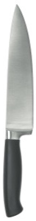







2-Player Resource Sharing Game tree representation
Making the cut vertically, $p$ is the percentage of the cookie’s area to the left of the cut
1
$$p=0$$
$$p=1$$
2
2
. . . . . . .
. . . . . . .
. . . .
$$left$$
2
$$left$$
$$right$$
$$right$$
$$p≈0.3$$
$$p≈0.8$$
$$left$$
$$right$$
$$(0,1)$$
$$\left(u_{1},u_{2}\right)=$$
$$(1,0)$$
$$(0,1)$$
$$(1, 0)$$
$$(1−p, p)$$
$$(p,1−p)$$
What is the SPE for this game? Why?
This is an example of “second mover advantage”!
Sometimes, a market follower has the advantage.

Slide 14
Game Tree Search
For what type of game variants is the Alpha Beta Pruning Algorithm designed?
Under what principle(s) does it work?
What are its best- and worst-case performances?
How well does it work, in practice?
On page 123, the authors discuss an “evaluation function”? What might we use as an evaluation function?

Slide 15
Questions & Discussion

